Slide 1
ABC Call Volume Trend Analysis
-final project-4

Slide 2
PROJECT DESCRIPTION:
The project is all about analyzing call center data and drawing meaningful insights from it. The efficiency and service quality of a call center, as defined by call volume, agent availability, and customer wait times, are crucial for customer experience management.
Understanding factors such as queue time, call duration, abandon rates, agent workload, and peak call hours can provide valuable insights for better decision-making in workforce planning and customer service optimization.
The project data is given in an Excel sheet, which should be cleaned and made ready for analysis.

Slide 3
TECH STACK USED:
SOFTWARE: MICROSOFT 365 WEB:
I used microsoft 365 web(EXCEL) online website to perform the excel operations.As the excel app is paid platform,I have used the online free site.It had all the operations of new version of excel(2021).
OPERATING SYSTEM: MacOS
My device is MacOs.I have used it as it is stable and efficient.

Slide 4
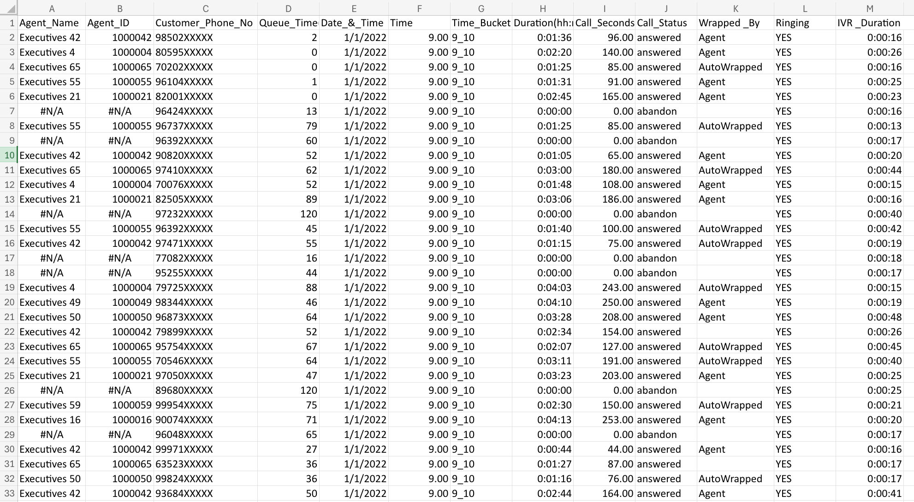
RAW DATA:
The given dataset has 13 columns and 1,17,989 records

Slide 5
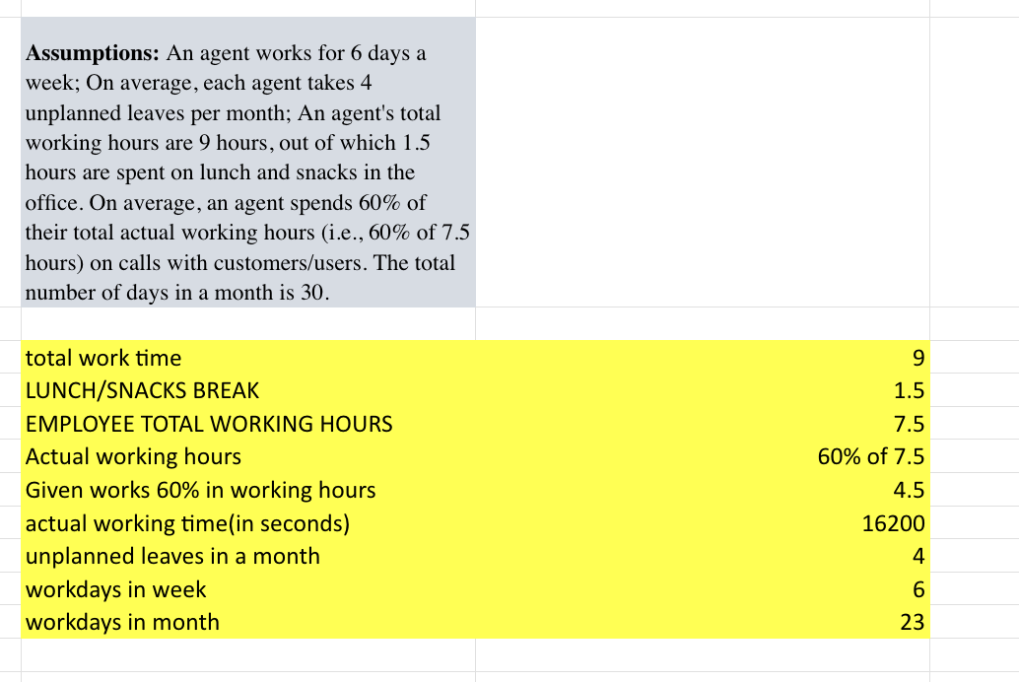
Assumptions given:

Slide 6
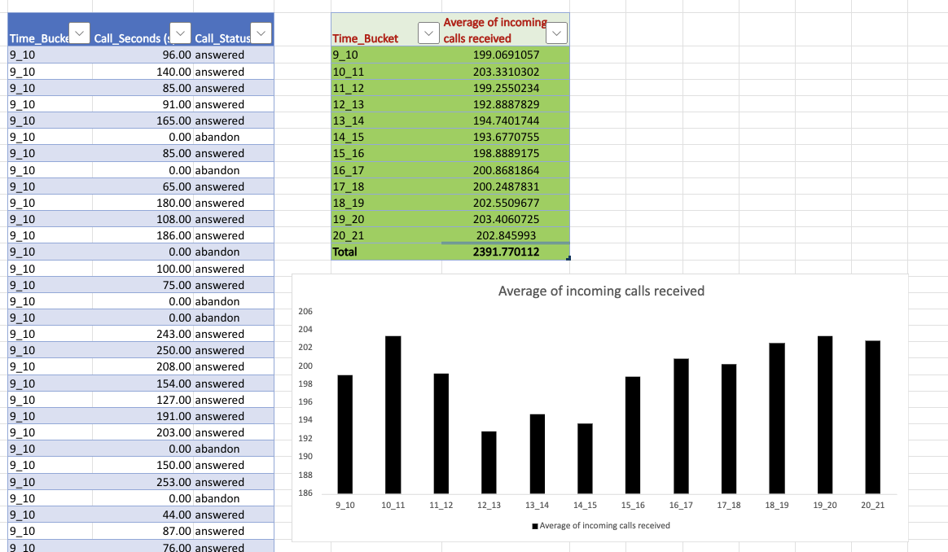
DATA ANALYTICS TASKS:
1.Average Call Duration: Determine the average duration of all incoming calls received by agents. This should be calculated for each time bucket.
Your Task: What is the average duration of calls for each time bucket?
FORMULAS USED =AVERAGEIFS(Table2[Call_Seconds(s)],Table2[Time_Bucket],F3,Table2[Call_Status],"answered")

Slide 7
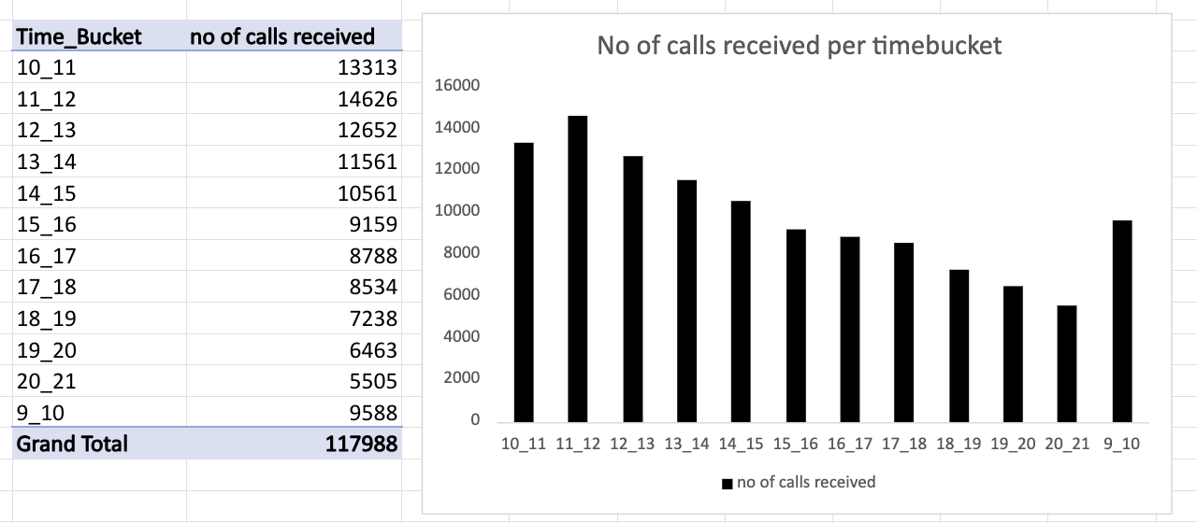
DATA ANALYTICS TASKS:
2.Call Volume Analysis: Visualize the total number of calls received. This should be represented as a graph or chart showing the number of calls against time. Time should be represented in buckets (e.g., 1-2, 2-3, etc.).
Your Task: Can you create a chart or graph that shows the number of calls received in each time bucket?

Slide 8
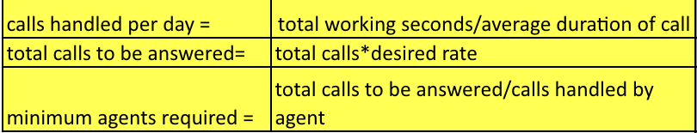
DATA ANALYTICS TASKS:
3.Manpower Planning: The current rate of abandoned calls is approximately 30%. Propose a plan for manpower allocation during each time bucket (from 9 am to 9 pm) to reduce the abandon rate to 10%. In other words, you need to calculate the minimum number of agents required in each time bucket to ensure that at least 90 out of 100 calls are answered.
Your Task: What is the minimum number of agents required in each time bucket to reduce the abandon rate to 10%?
FORMULAS USED:

Slide 9
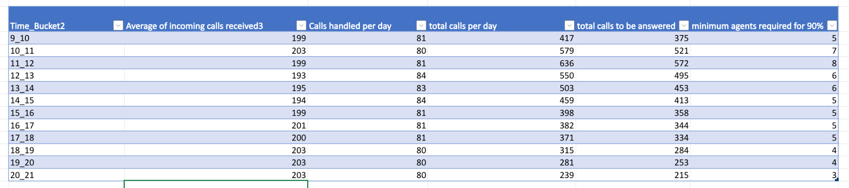
DATA ANALYTICS TASKS:
3.Manpower Planning:

Slide 10
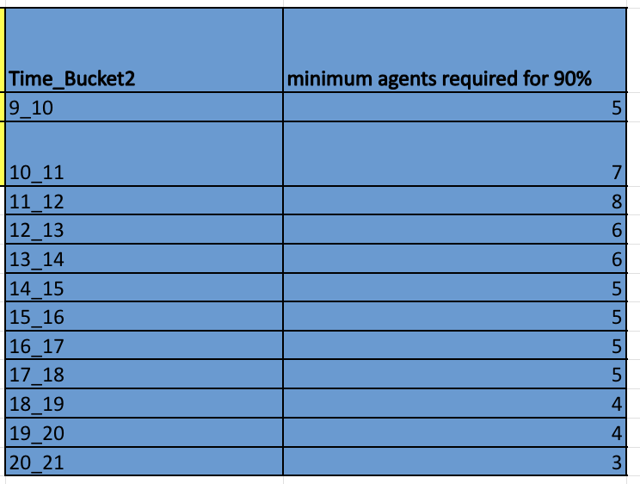
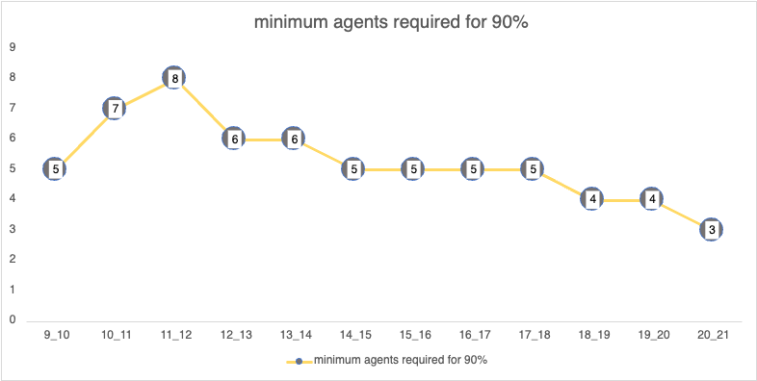
DATA ANALYTICS TASKS:
3.Manpower Planning:

Slide 11
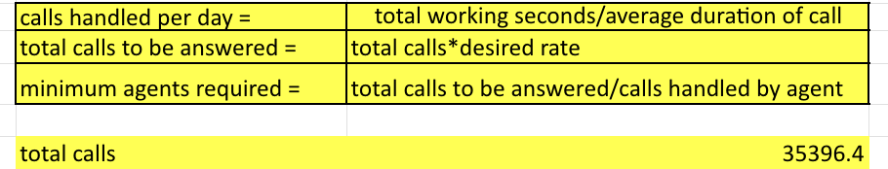
DATA ANALYTICS TASKS:
4.Night Shift Manpower Planning: Customers also call ABC Insurance Company at night but don't get an answer because there are no agents available. This creates a poor customer experience. Assume that for every 100 calls that customers make between 9 am and 9 pm, they also make 30 calls at night between 9 pm and 9 am. The distribution of these 30 calls is as follows:
Your Task: Propose a manpower plan for each time bucket throughout the day, keeping the maximum abandon rate at 10%.

Slide 12
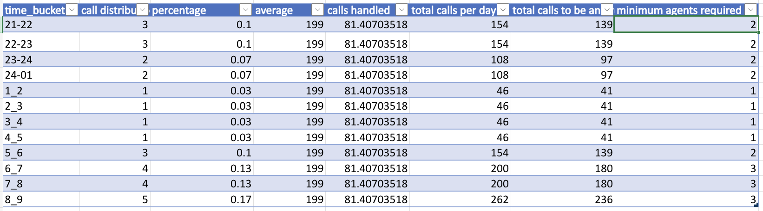
DATA ANALYTICS TASKS:
4.Night Shift Manpower Planning:

Slide 13
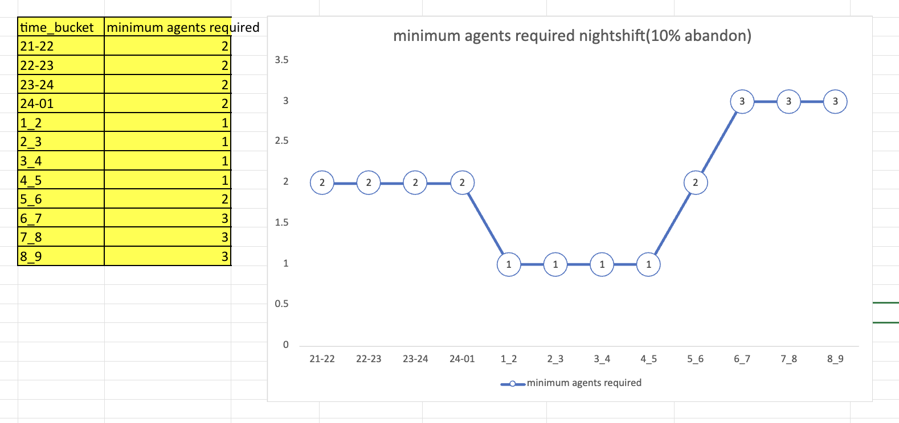
DATA ANALYTICS TASKS:
4.Night Shift Manpower Planning:

Slide 14
INSIGHTS:
A. Average Call Duration Analysis: Found out how long calls typically last in each time slot to understand agent workload and customer interaction time.
B. Call Volume Analysis: Created visualizations to see when the most calls come in, helping identify peak hours and quieter periods.
C. Manpower Planning: Checked how many agents are needed in each time slot to bring down the abandoned call rate from 30% to 10%.
D. Night Shift Manpower Planning: Looked at the number of calls coming in at night and suggested a staffing plan to ensure customers get support with minimal wait times.

Slide 15
RESULT:
By the project, I have analyzed call volume and customer service data, including queue time, call duration, agent availability, and abandoned calls.
I identified how each factor influences customer experience, service efficiency, and manpower planning.
This project had a good impact on understanding call patterns, optimizing workforce allocation, and improving overall call center performance.

Slide 16
REFERENCE LINK:
The link for excel sheet file:
excel_link

Slide 17
THANK YOU

